Slide 1
Comparative Advantage and Economic Growth
Steven Suranovic
George Washington University

Slide 2
Model Assumptions
Suppose there are 3 sisters named Olga, Maria and Irene in a household
Each sister can work to produce apples or oranges, with different productivities for each good
The sisters desire to produce as many apples and oranges as they can between them

Slide 3
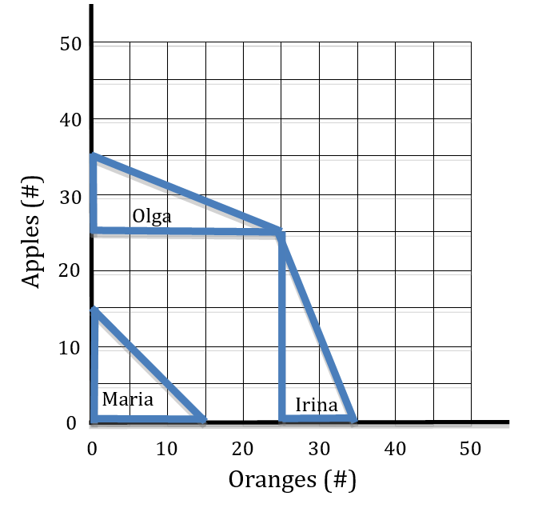
A 3-person Production Possibility Frontier
Assume …
Maria can produce 15 oranges or 15 apples in a day
Olga can produce 25 oranges or 10 apples in a day
Irina can produce 10 oranges or 25 apples in a day
Who should produce what?

Slide 4
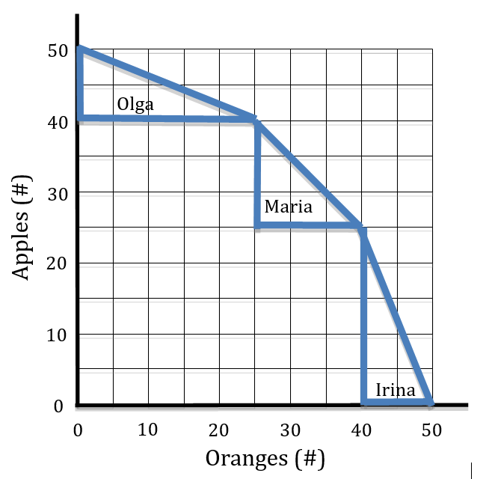
A 3-person Production Possibility Frontier
Starting from all apple and no orange production ….
Production of oranges should begin with the sister whose OCOR is the lowest (Olga), then the next lowest (Maria), and finally the highest (Irina)
This yields a PPF that is farthest out towards the upper-right (towards more of both goods)
Producing on the PPF means producing based on Comparative Advantage

Slide 5
A 3-person Production Possibility Frontier
Use diagram to explain
Inefficient production
Efficient production
Feasible production
Infeasible production

Slide 6
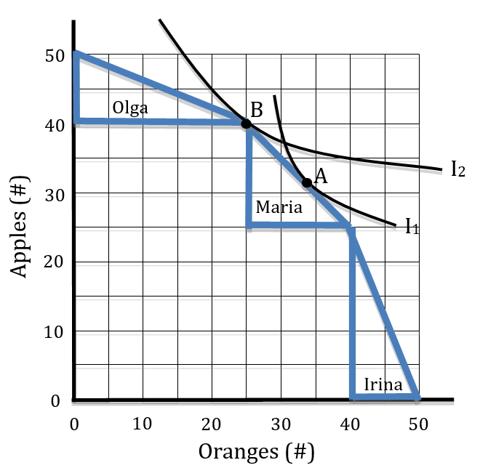
Maximizing Household Utility
Consider two different sets of household preferences represented by I1 and I2
I1 preferences have stronger desires for oranges than I2
I1 preferences would lead to point A as the utility maximum
Olga produces oranges, Irina apples, and Maria diversifies
I2 preferences would lead to point B as the utility maximum
Olga produces oranges, Maria and Irina produce apples

Slide 7
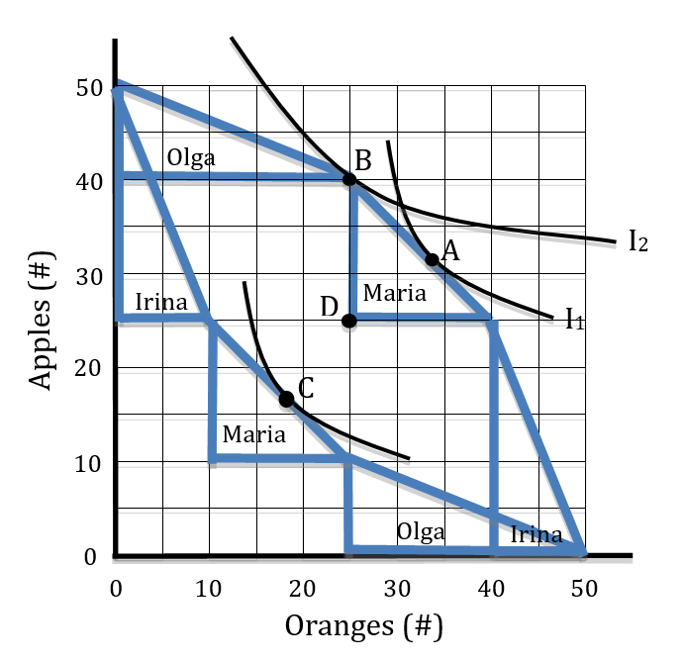
Production Not Based on Comparative Advantage
Suppose Irina insists on being the first to produce oranges and Olga insists on being last producing oranges.
→ Production at C has each sister working full time but Irina and Olga are not producing based on CA
Production is inefficient (inside the efficient frontier (PPF)), resources are wasted.

Slide 8
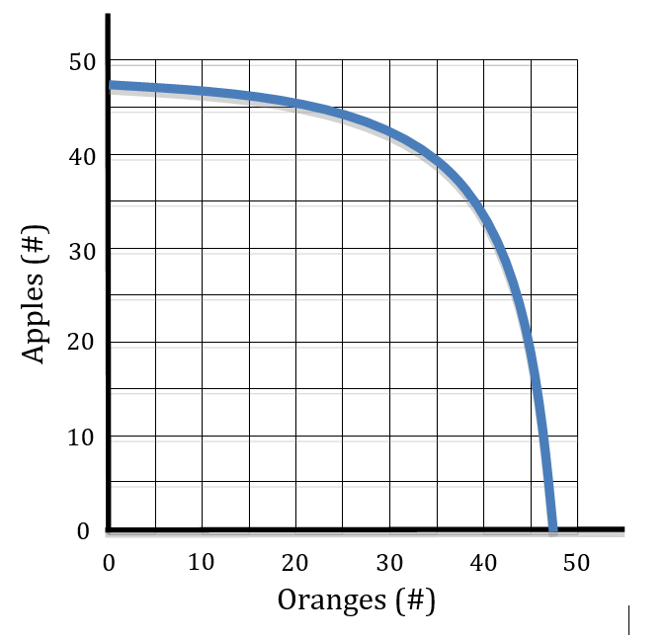
A National Aggregate PPF
Suppose there are numerous individuals (resources) lined up along the PPF from lowest to highest OC for oranges
→ smooth continuous PPF
Called an increasing cost PPF, because the OC for oranges rises from left to right
Early resources are the most suitable for oranges, late resources are the least suitable

Slide 9
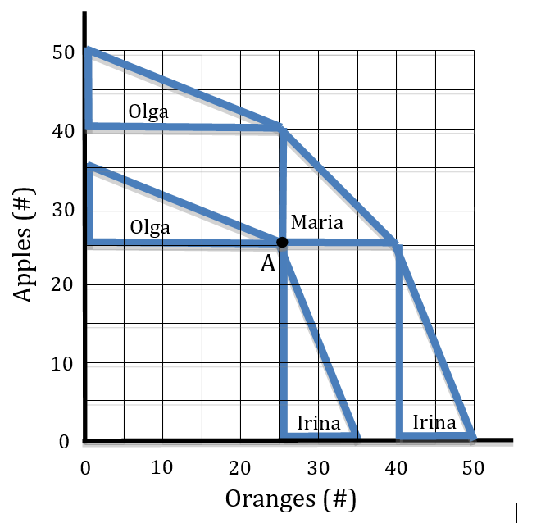
Sources of Economic Growth
Increase in Resources
If only Olga and Maria produce the PPF is lower.
Add Maria (another productive resource) and the PPF shifts outward
Greater production of both goods is possible

Slide 10
Sources of Economic Growth
Reemployment of Unemployed Resources
If Maria was unemployed, PPF is the lower boundary
If Maria returns to work, the PPF frontier is larger
Usually we would say if Maria is part of the labor force but does not work, then production occurs inside the efficient frontier

Slide 11
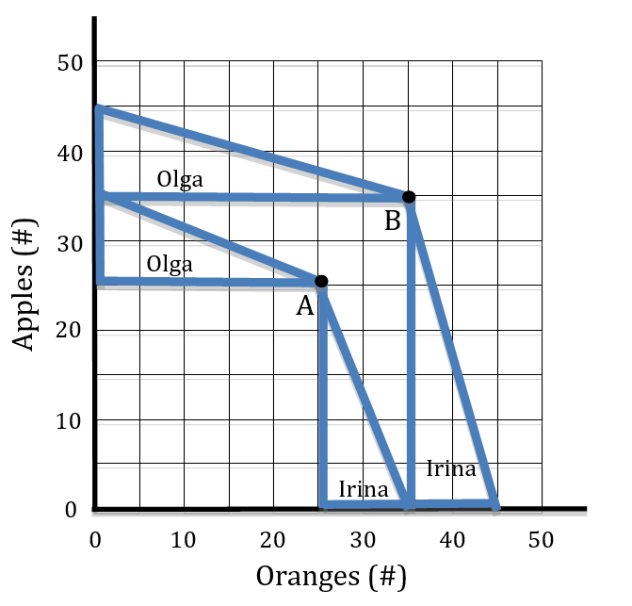
Sources of Economic Growth
Increase in productivity / technology improvement
Diagram shows Olga’s productivity of oranges rising from 25 to 35 or/hr
Diagram shows Irina’s productivity of apples rising from 25 to 35 ap/hr
PPF shifts outward

Slide 12
Sources of Economic Growth
Rearrange production on the basis of comparative advantage
Diagram shows inefficient production when Olga and Irina produce the “wrong” good.
When they produce the “right” good (i.e. their CA good), they can reach the efficient frontier

